Slide 1

Chapter 3 – S3+S4
The essential JavaScript statements
Notes:
Session: Ghi số thứ tự session trong môn học
Session Name: ghi tên của session sẽ dạy

Slide 2
Objectives
How to code conditional expressions
How to code the basic control statements
Three illustrative applications
How to work with arrays
The Test Scores application with an array
Notes:
Mô tả nội dung mà học viên phải đạt được khi kết thúc môn học này

Slide 3
How to code conditional expressions
Notes:
Session: Ghi số thứ tự session trong môn học
Session Name: ghi tên của session sẽ dạy

Slide 4
Conditional Expression
Conditional expression are expressions that evaluate to either true or false.
It uses in if statement and loop statement.
Relational operators is used to compare the result of two expression and return Boolean value.
Logical operators is used to join two or more conditional expression to be a compound conditional expression.
Notes:
Logical : ˈläjikəl

Slide 5
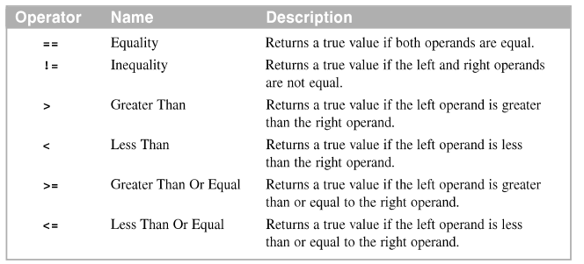
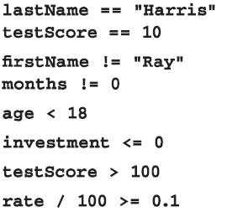
The relational operators
Example:

Slide 6
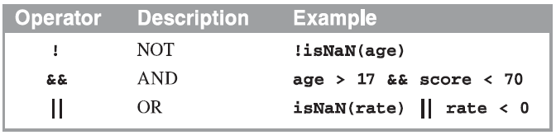
The logical operators

Slide 7
How to code
the basic control statements
Notes:
Session: Ghi số thứ tự session trong môn học
Session Name: ghi tên của session sẽ dạy

Slide 8
IF statement
Syntax:
if (booleanExpression) {
statements;
}
If (booleanExpression) {
statements1;
}else{
statements2;
}

Slide 9
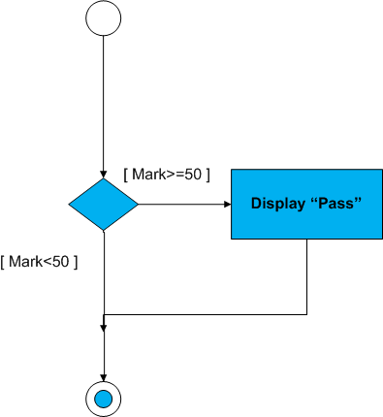
IF statement (cont.)
Condition
Condition

Slide 10
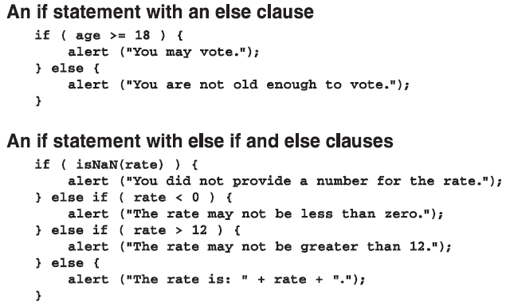
IF statement (cont.)

Slide 11
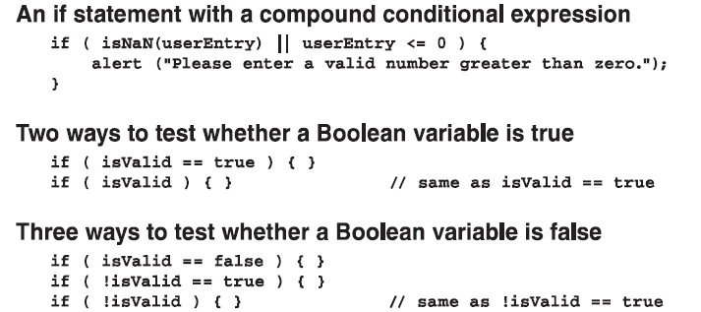
IF statement (cont.)

Slide 12
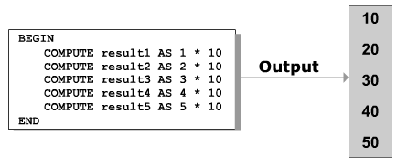
Loops

Slide 13
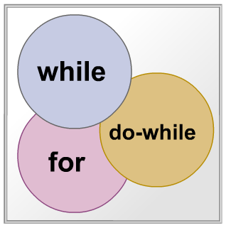
Types of Loops
A loop comprises a statement or block of statement s that are execute repeatedly until a particular condition evaluate to true or false

Slide 14
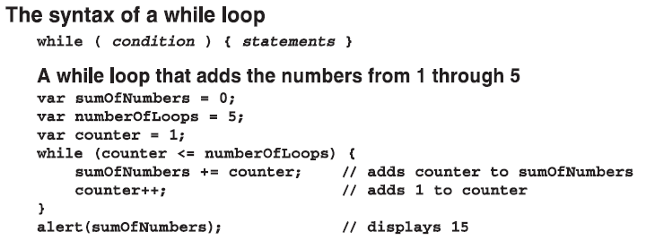
while loop
while loop statement is used to execute a statement or block of statement while a particular condition is true

Slide 15
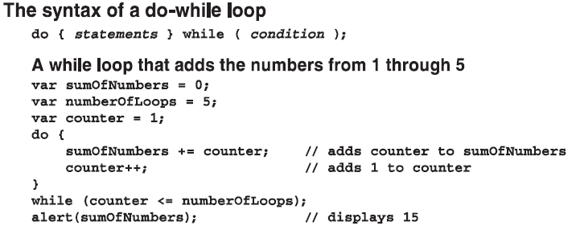
do-while Statement
The do-while statement check the condition at the end of the loop rather than at the beginning to assure that the loop is executed at least once.

Slide 16
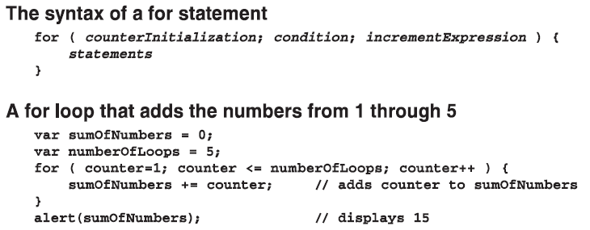
for Statement

Slide 17
Three illustrative applications
(Page 96-101)
Notes:
Session: Ghi số thứ tự session trong môn học
Session Name: ghi tên của session sẽ dạy

Slide 18
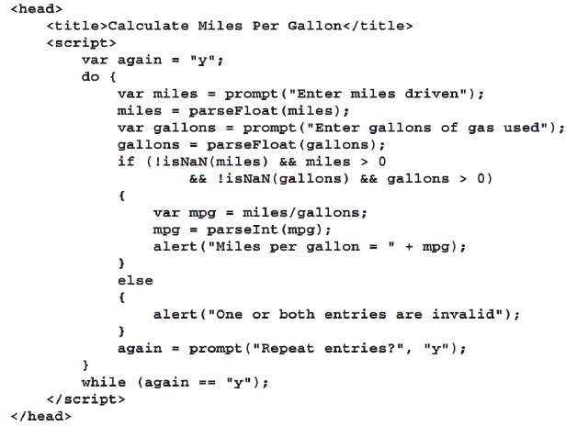
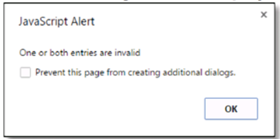
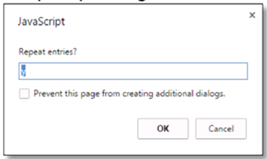
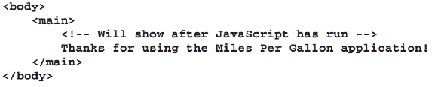

Slide 19
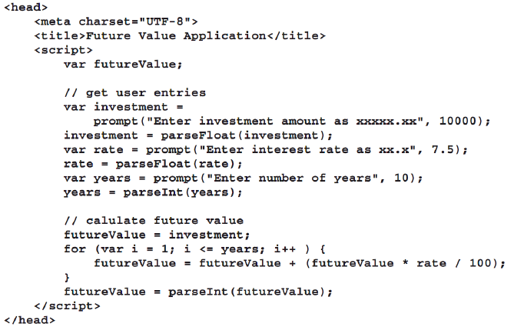
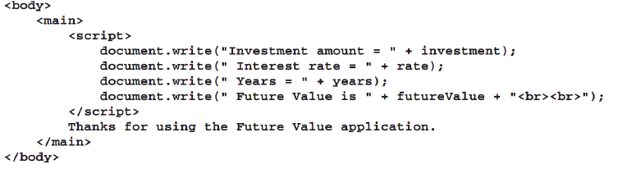
Future Value application

Slide 20
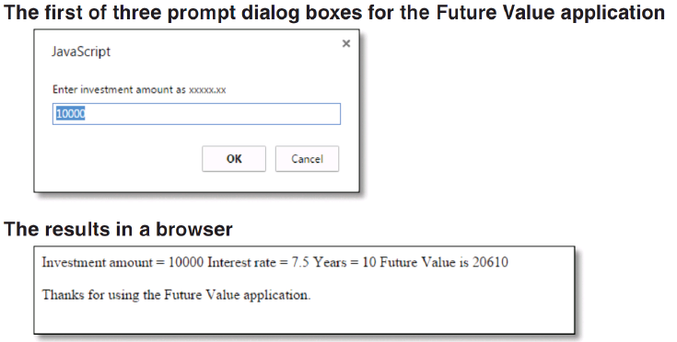
Future Value application (result)

Slide 21
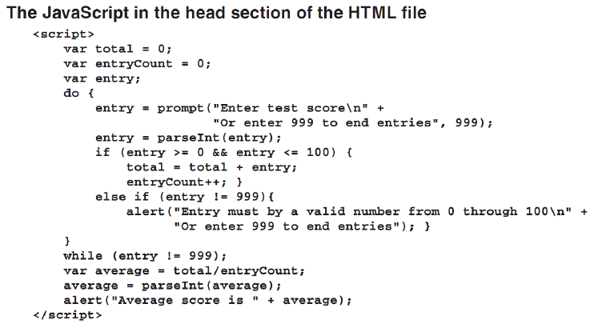
The enhanced Test Scored application

Slide 22
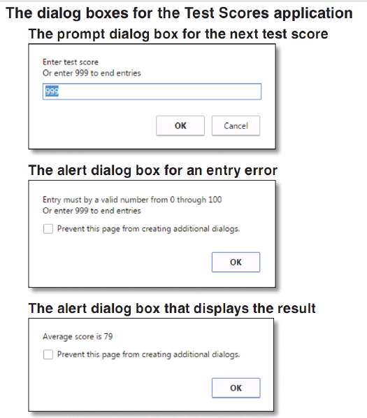

Slide 23
How to work with arrays
Notes:
Session: Ghi số thứ tự session trong môn học
Session Name: ghi tên của session sẽ dạy

Slide 24
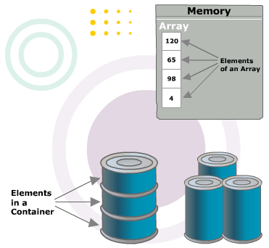
Introduction to Array
An array can store one or more elements
The length of an array is the number of elements in the array
Each of the element in the array is accessible through an integer value called a subscript
An array subscript begins from zero and is also called array index

Slide 25
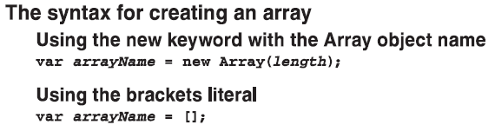
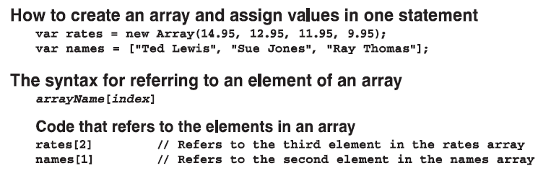
How to create and use arrays

Slide 26
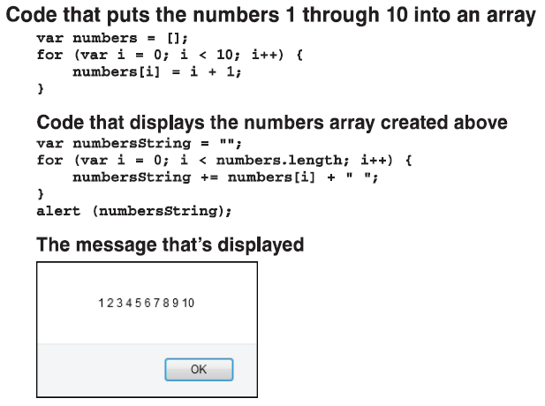
How to use for loops to work with arrays

Slide 27
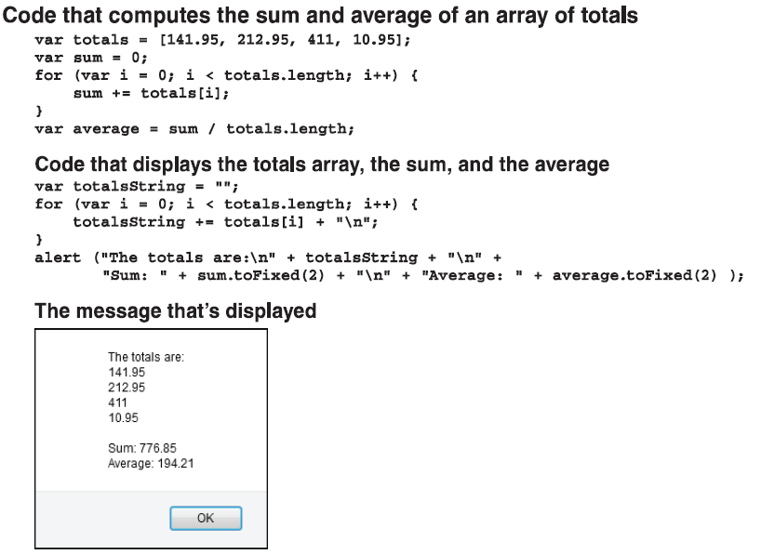
How to use for loops to work with arrays (cont.)

Slide 28
The Test Score application with an array (Page 106-107)

Slide 29
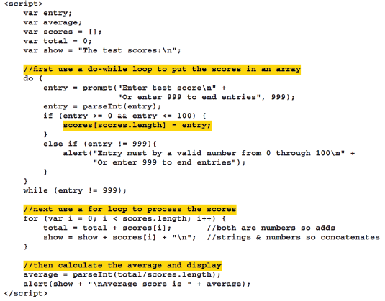
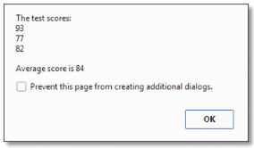

Slide 30
Summary
Conditional expression are expressions that evaluate to either true or false. It uses in if statement and loop statement.
A loop comprises a statement or block of statement s that are execute repeatedly until a particular condition evaluate to true or false.
An array can store one or more elements. The length of an array is the number of elements in the array
Each of the element in the array is accessible through an integer value called a subscript.
Notes:
Tóm tắt lại nội dung đã học

